Slide 1



THE
RHODES SCHOLARSHIP
Information for Academic Advisors

Slide 2




What is the Rhodes Scholarship?
Basics, History, selection and eligibility criteria
Why encourage your students to apply?
Benefits, why it is unique and Scholar experience
How can you help students to apply?
What they need, referees requirements etc.

Slide 3
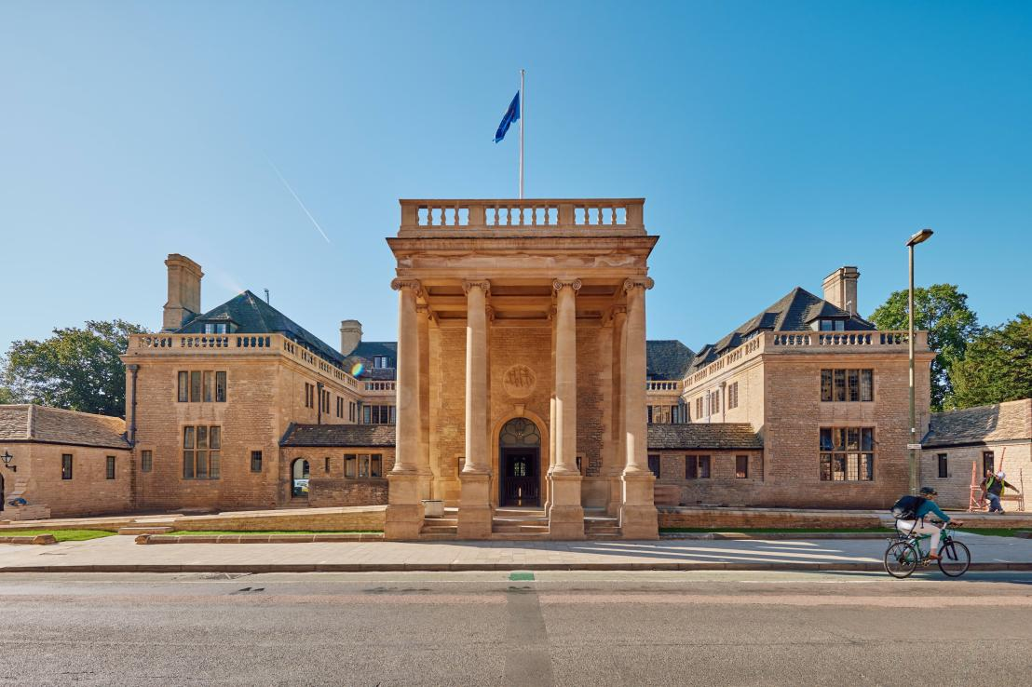

What is the Rhodes Scholarship?

Slide 4

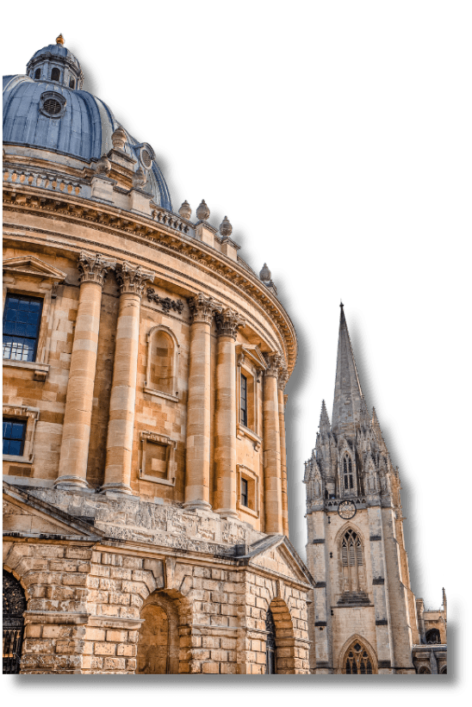
What is the Rhodes Scholarship?
The Rhodes Scholarship was established through the Will of Cecil John Rhodes in 1902. Over a hundred years later, the Rhodes Scholarships are the oldest and perhaps most prestigious international scholarship programme in the world.
Our reputation as the world's most distinguished academic scholarship rests not on the controversial life of our founder Cecil Rhodes, but on the enormous contributions our Scholars have made to the world.
And the qualities sought in a Rhodes Scholar - intellectual distinction combined with concern for others, energy to lead, and a focus on public service - remain as compelling as they were over a century ago.

Slide 5



What is the Rhodes Scholarship?
  The Rhodes Scholarship is a fully funded, full time, postgraduate award which enables talented young people from around the world to study at the University of Oxford.
  Applying for the Scholarship is a challenge, and it is an experience which has helped generations of young people to succeed. We encourage applications from talented students everywhere.
  Rhodes Scholars come to the UK for two or more years and can apply to study most full-time postgraduate courses offered by Oxford University.

Slide 6


What are the Selection Criteria?
We are looking for young people of outstanding intellect, character, leadership, and commitment to service.
The criteria which were laid out in the Founder’s Will, and have remained largely unchanged since 1902, still guide us today:
  Literary and scholastic attainments (academic excellence);
  Energy to use one's talents to the full (as demonstrated by mastery in areas such as sports, music, debate, dance, theatre, and artistic pursuits, particularly where teamwork is involved);
  Truth, courage, devotion to duty, sympathy for and protection of the weak, kindliness, unselfishness and fellowship;
  Moral force of character and instincts to lead, and to take an interest in one's fellow beings.

Slide 7
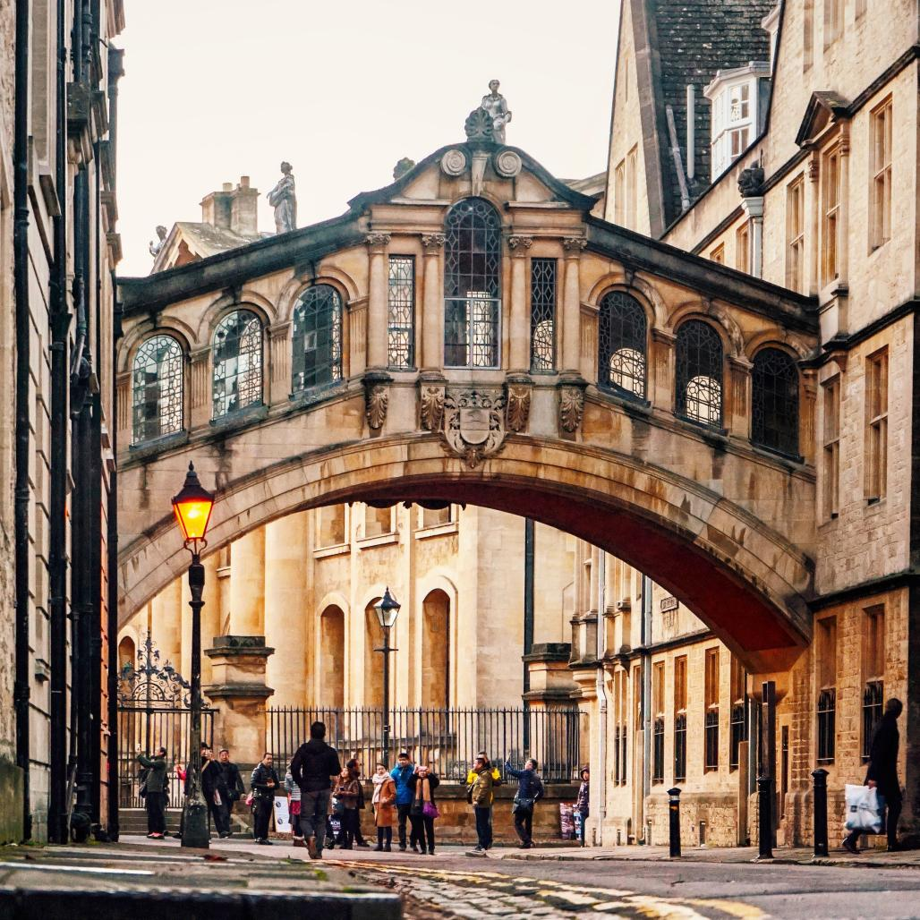
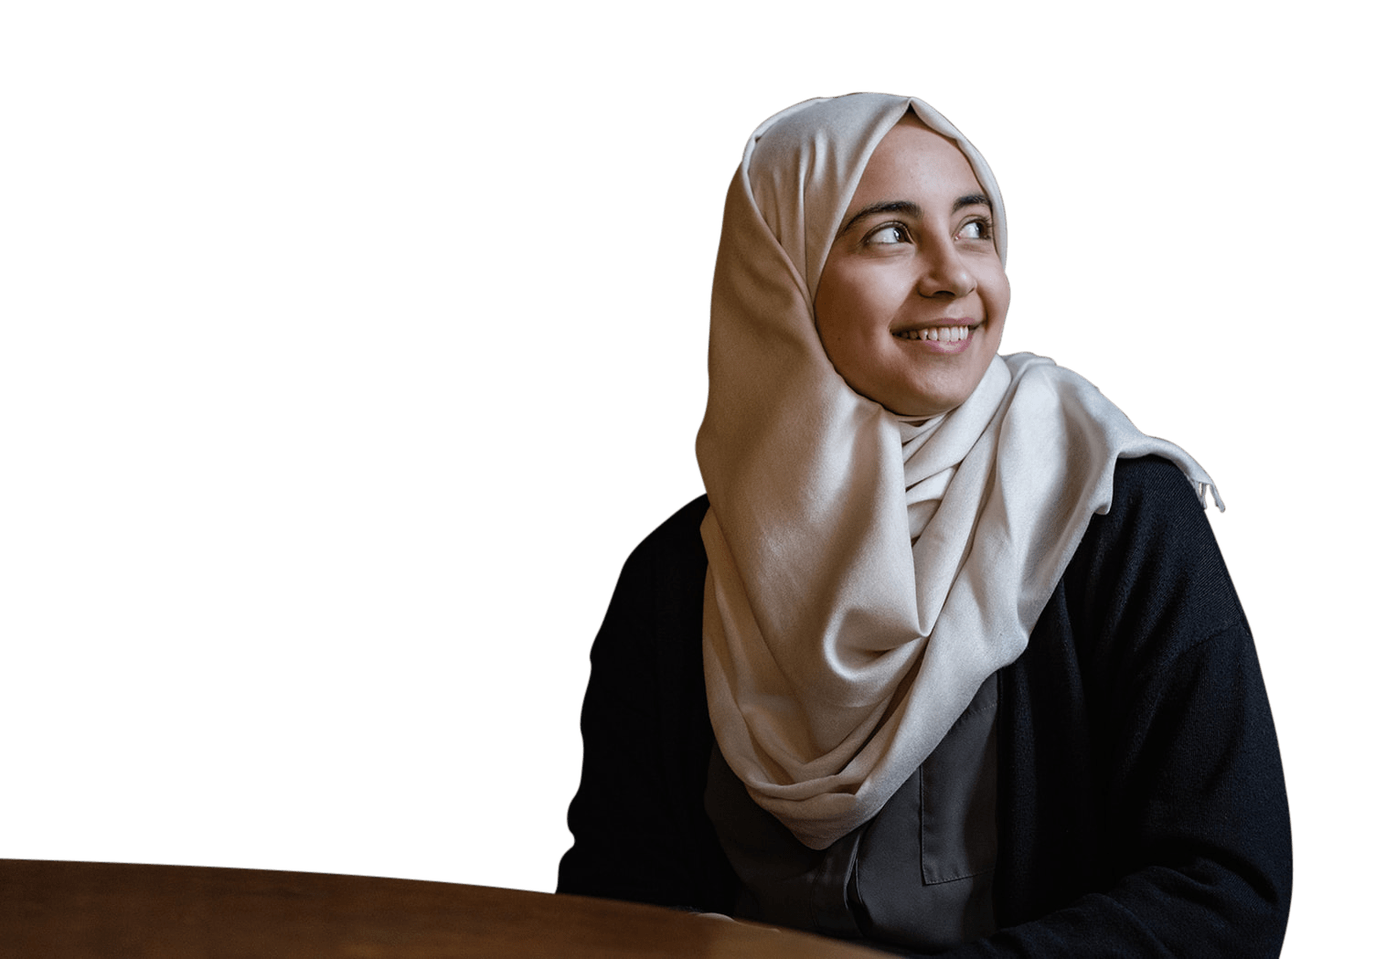
Why encourage students to apply?

Slide 8


Benefits of Encouraging Applications
  Broadening Student's Horizons:
Studying abroad on the Rhodes Scholarship at Oxford University will give your students different perspectives and many opportunities to learn in one of the world’s most cutting-edge academic environments.
  Institutional Reputation:
Student and staff populations can take pride in their university/department producing a Rhodes Scholar who will study at Oxford and represent their community.
  Outreach:
A winning Rhodes Scholar gains significant media coverage and so will raise awareness of your university. Future students with aspirations for the Rhodes may be more likely to apply to the university.

Slide 9
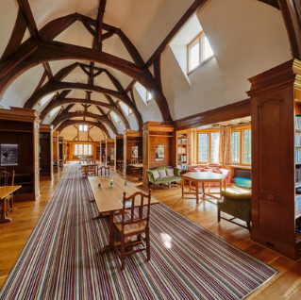

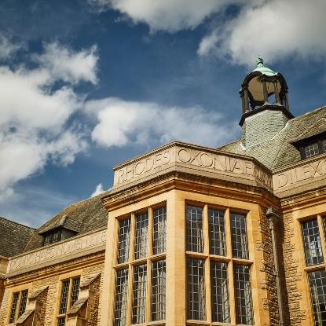


What makes the Scholarship Unique?
Rhodes Scholars unlike other scholarships join for a lifetime, a unique and vibrant international community of Scholars. Our Character, Service and Leadership Programme form part of the scholar’s personal training.
Unlike other Oxford University Students they’ll have Rhodes House...
  Rhodes House hosts talks, seminars and forums with world leading experts and guests.
  It's where the Registrar, the Dean, and the Warden are based.
  There are study spaces, libraries and social events where you will meet other Scholars.
  Scholars also attend social events like the Coming Up Dinner and Rhodes Ball.

Slide 10

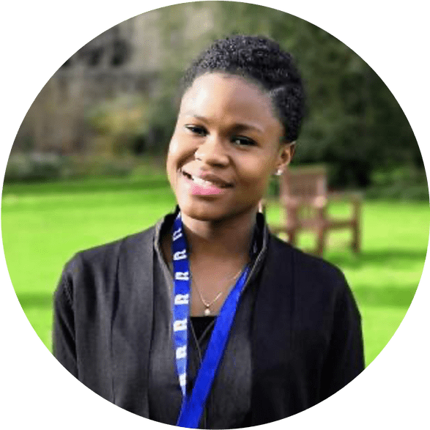


What do Rhodes Scholars say?
"Rhodes House has afforded me the opportunity to make lifelong friendships with great minds from diverse backgrounds, from whom I have learned so much."
Emmanuelle Dankwa
(West Africa & St Peter's 2018)
"The thing I enjoyed the most about Rhodes House was how so many Scholars from so many different backgrounds are put together, forcing us to embrace our differences and learn from each other's cultures."
Xilin Jiang
(China & University 2017)
"There is nothing quite like the opportunity to so fully invest in your vision for the future and I am thrilled to be able to embark on this journey."
Wakithi Mabaso
(South Africa-at-Large 2022)

Slide 11


How can you help students to apply?

Slide 12

Are they eligible?
Each year, 100+ Rhodes Scholarships are awarded, to students from 25 constituencies (country or group of countries):
Australia
India
Southern Africa
Bermuda
Israel
Syria, Jordan, Lebanon & Palestine (SJLP)
Canada
Jamaica
China
Kenya
United Arab Emirates
Commonwealth Caribbean
Malaysia
United States
East Africa
New Zealand
West Africa
Germany
Pakistan
Zambia
Global
Saudi Arabia
Zimbabwe
Hong Kong
Singapore

Slide 13

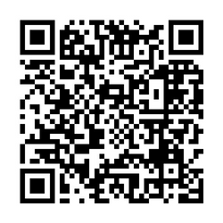
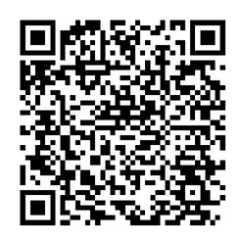
Are they eligible?
Each applicant must fulfil the citizenship and residency requirements of the Rhodes constituency for which they are applying.
Age limits vary between constituencies, ranging between 18 to 24 years and up to a maximum of 26 years in exceptional circumstances.
They must have completed an undergraduate degree (usually a Bachelor’s) by July 2025, and they must have an academic background and grade that - at a minimum - meets or exceeds the specific entry requirements of their chosen course at the University of Oxford.
Candidates will have a higher chance of successful admission to Oxford if they have:
  A First Class Honours Degree or equivalent, or,
  A GPA of 3.70/4.0 or higher
Oxford Graduate Course List
International Qualifications
Equivalence

Slide 14





The Application Process
Applications Opening and Closing
Rhodes Interview and Selection
Oxford Application
Arrive in Oxford!
June/July 2024
October - November 2024
December 2024 - March 2025
September 2025

Slide 15










What do they need?
Birth Certificate
Passport
Transcript
Evidence of Residence
Personal Statement
CV/Resume
Evidence of
English Language Proficiency
Head and Shoulders Photo
Reference Letters
Academic Statement

Slide 16
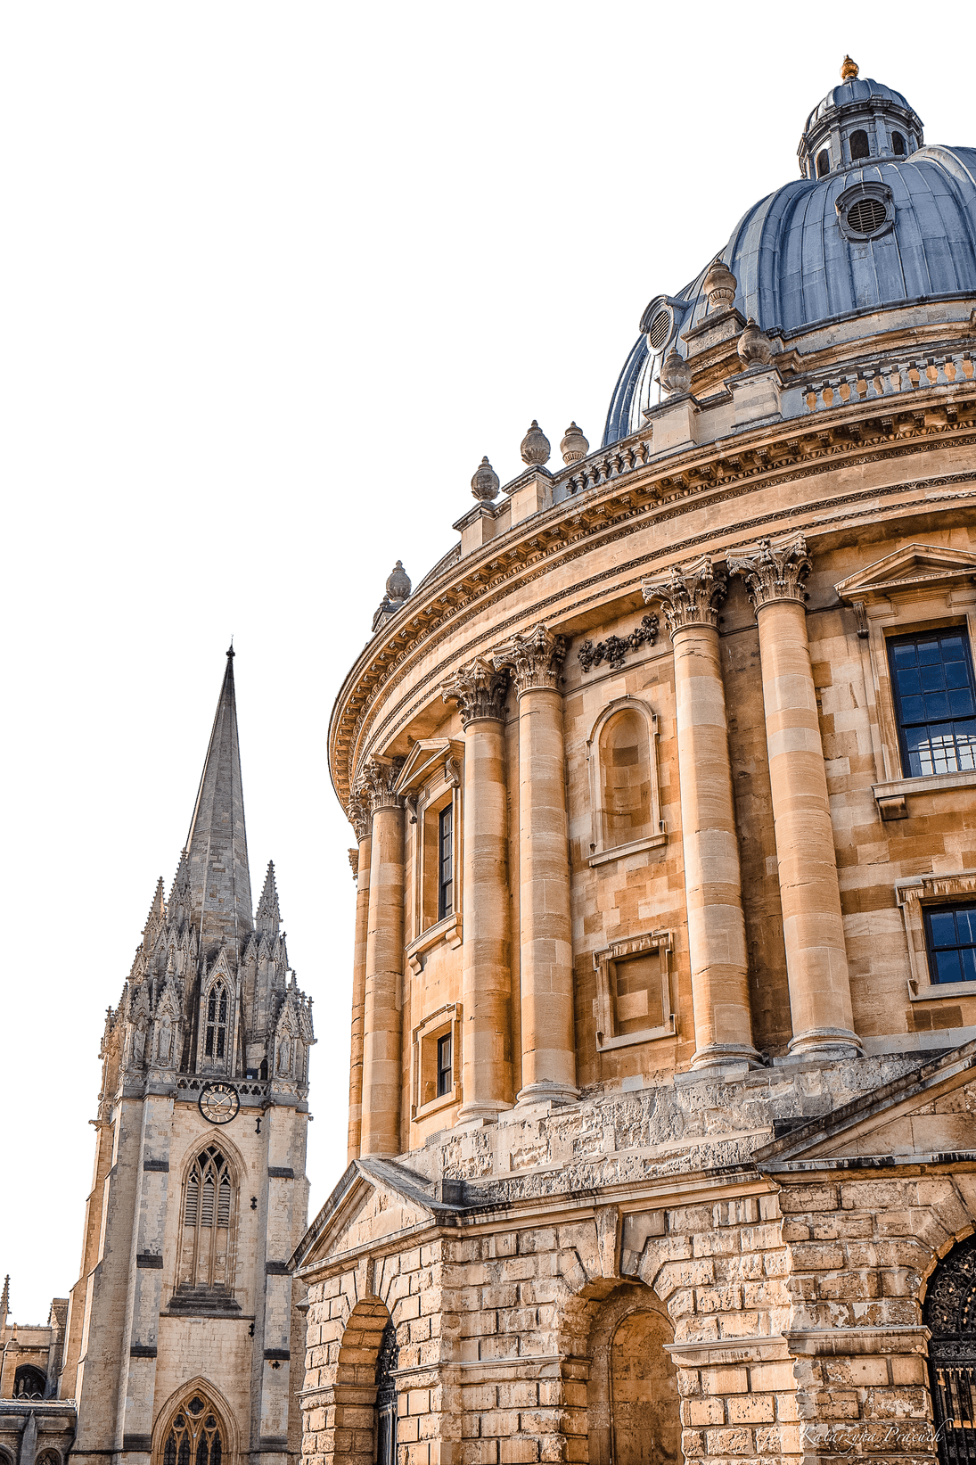
The reference letters - How can you help?
References form a crucial part of the selection process, and therefore a reference could make the difference to an applicant’s success.
  Make sure you understand what’s required from you, read the guidance for referees
  You can ask the applicant their CV, transcript, papers they have written in class etc.
  Can you speak to both their strengths and weaknesses?
  What experiences they had can you speak to that would draw out the best of their qualities and values?

Slide 17

ASK:
EXPLAIN:
PREPARE:
Is the Rhodes Scholarship right for you?
How the application process works
Interview Preparation
  Are they eligible?
  What do they want to achieve with the Rhodes?
  Do they meet the Rhodes selection criteria?
  Would other scholarship opportunities be better suited?
  Help them think about which referees would be best
  Recommend that they check the Rhodes Trust website, and review the 'resources' section
  Have they started to think about their personal statement?
  Have they done a professional interview before?
  Recommend practicing interview skills, and that they ask for help with mock interviews

Slide 18



Contact:
  Get in touch with us by emailing outreach@rhodeshouse.ox.ac.uk
  Access shareable outreach resources (presentations and flyers) and more information on our website
  Follow us on X, Facebook, Instagram and LinkedIn

