Slide 1



THE
RHODES SCHOLARSHIP

Slide 2






What is the Rhodes Scholarship?
Basics, History, Funding & Fees, Social Life
Could you be a Rhodes Scholar?
Selection Criteria and Eligibility
How to Apply?
What You Need, The Process, Resources
Mythbusting the Scholarship

Slide 3


What is the Rhodes Scholarship?
  The Rhodes Scholarship is a fully-funded, full time, postgraduate award which enables talented young people from around the world, to study at the University of Oxford.
  We encourage applications from talented students everywhere.
  Applying for the Scholarship is a challenge, but it is an experience which has helped generations of young people to succeed.
  Rhodes Scholars come to the UK for two or more years and can apply to study any postgraduate course offered by Oxford University.
www.rhodeshouse.ox.ac.uk/apply

Slide 4
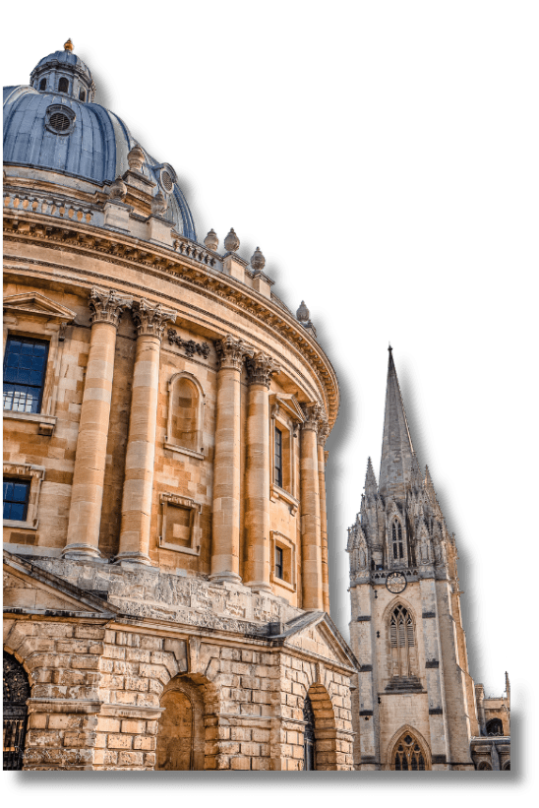
What is the Rhodes Scholarship?
The Rhodes Scholarship was established through the Will of Cecil John Rhodes in 1902. Over a hundred years later, the Rhodes Scholarships are the oldest and perhaps most prestigious international scholarship programme in the world.
Our reputation as the world's most distinguished academic scholarship rests not on the controversial life of our founder Cecil Rhodes, but on the enormous contributions our Scholars have made to the world.
And the qualities sought in a Rhodes Scholar - intellectual distinction combined with concern for others, energy to lead, and a focus on public service - remain as compelling as they were over a century ago.

Slide 5


What does the Rhodes Scholarship Cover?
  The Rhodes Scholarship covers Oxford University (and College) fees, as well as providing an annual stipend.
  Following selection for the Scholarship, the Rhodes Trust will cover the fee required to apply to study at the University of Oxford.
  The Trust will cover the fee for a Tier 4 study visa and the associated International Health Surcharge (IHS).
  We cover two economy class flights - to and from the UK - for the beginning and end of studies in Oxford. On arrival in Oxford, Scholars also receive a settling in allowance.

Slide 6
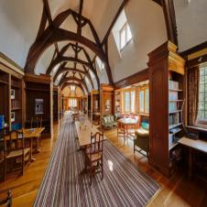


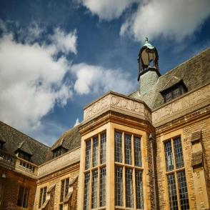

What makes the Scholarship Unique?
Rhodes Scholars unlike other scholarships join for a lifetime, a unique and vibrant international community of Scholars. Our Character, Service and Leadership Programme form part of the scholar’s personal training.
Unlike other Oxford University Students you'll have Rhodes House...
  There are study spaces, libraries and social events where you will meet other Scholars.
  Scholars also attend social events like the Coming Up Dinner and Rhodes Ball.
  It's where the Registrar, the Dean, and the Warden are based.
  Rhodes House hosts talks, seminars and forums with world leading experts and guests.

Slide 7

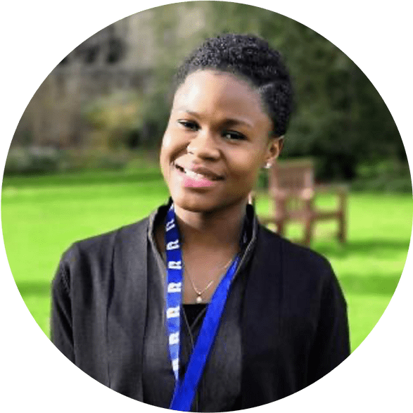


What do Rhodes Scholars say?
"Rhodes House has afforded me the opportunity to make lifelong friendships with great minds from diverse backgrounds, from whom I have learned so much."
Emmanuelle Dankwa
(West Africa & St Peter's 2018)
"The thing I enjoyed the most about Rhodes House was how so many Scholars from so many different backgrounds are put together, forcing us to embrace our differences and learn from each other's cultures."
Xilin Jiang
(China & University 2017)
"There is nothing quite like the opportunity to so fully invest in your vision for the future and I am thrilled to be able to embark on this journey."
Wakithi Mabaso
(South Africa-at-Large 2022)

Slide 8




Could you be a Rhodes Scholar?
Rhodes Scholars come from all backgrounds and we welcome applications from talented young persons of diverse backgrounds.
Energy to use one's talents to the full as demonstrated by mastery in areas such as sports, music, debate, dance, theatre, and artistic pursuits, particularly where teamwork is involved.
Academic achievement and excellence.
What do we look for in a candidate?
The courage and skills required to lead with a wider desire for public good.
Truth, courage, devotion to duty, sympathy for and protection of the weak, kindliness, unselfishness and fellowship.

Slide 9
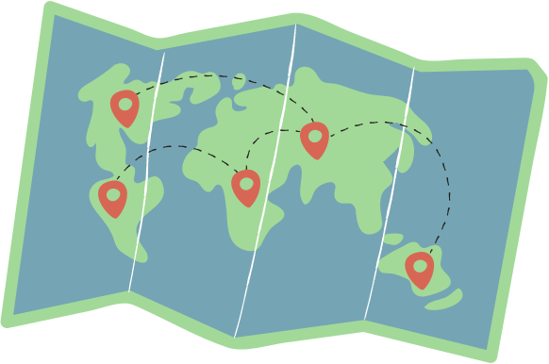
Are you eligible?
Each year, 100+ Rhodes Scholarships are awarded, to students from 25 consitutencies (country or group of countries):
Australia
India
Southern Africa
Bermuda
Israel
Syria, Jordan, Lebanon & Palestine (SJLP)
Canada
Jamaica
China
Kenya
United Arab Emirates
Commonwealth Caribbean
Malaysia
United States
East Africa
New Zealand
West Africa
Germany
Pakistan
Zambia
Global
Saudi Arabia
Zimbabwe
Hong Kong
Singapore

Slide 10

Are you eligible?
Each applicant must fulfil the citizenship and residency requirements of the Rhodes constituency for which they are applying.
Age limits vary between constituencies, ranging between 19 to 24 years and up to a maximum of 26 years in exceptional circumstances.
You must have completed, or be in the processing of completing, an undergraduate degree with a GPA of 3.7 out of 4 or higher, or the equivalent academic level in your country.

Slide 11










What do you need?
Birth Certificate
Evidence of Residence
Personal Statement
Passport
Transcript
Evidence of
English Language Proficiency
Head and Shoulders Photo
Reference Letters
Academic Statement
CV

Slide 12





The Application Process
Applications Opening and Closing
Rhodes Interview and Selection
Oxford Application
Arrive in Oxford!
June - September
October - December
December - March
September
www.rhodeshouse.ox.ac.uk/apply

Slide 13


MYTH NUMBER ONE
We welcome applications from talented young persons of diverse backgrounds. Selection is made without regard to gender, gender identity, marital status, sexual orientation, race, ethnic origin, colour, religion, social background, caste, or disability.
I’m not the type of person who can win a Rhodes Scholarship.

Slide 14
Mythbusting the Scholarship
MYTH NUMBER TWO
Academic excellence is important as you will need to be able to gain entry to the
University of Oxford; however, equally important is your commitment to serve
others.
I have to be top of my class.

Slide 15
Mythbusting the Scholarship
MYTH NUMBER THREE
We now offer two Global Scholarships for eligible candidates from the rest of the world (i.e. not connected to any other of our Constituencies) to apply for a Scholarship
I can’t apply because my country is not listed as a Rhodes constituency.

Slide 16
Mythbusting the Scholarship
MYTH NUMBER FOUR
As long as you demonstrate that you have worked to improve the lives of others, is what counts. It can be done in a multitude of ways in your own neighbourhood. You will also need to be able to talk in the interview about what you hope to do in the future.
You have to have done months of volunteer work abroad or started your
own NGO.

Slide 17
Mythbusting the Scholarship
MYTH NUMBER FIVE
Today’s Rhodes Scholars include Presidents and Prime Ministers, but also medical
researchers, social workers, artists, journalists, lawyers, teachers, activists, poets, doctors and many more!
Most Scholars end up as political leaders.

Slide 18






Stay in Touch!
Find out more about the Scholarship and apply by visiting our website:
www.rhodeshouse.ox.ac.uk/apply
Our social media is a great place to learn more about the Scholarship - keep track of key application dates, access useful resources, and ask current Rhodes Scholars questions about Oxford during Instagram takeovers. You can find us at the channels above!

Slide 19
www.rhodeshouse.ox.ac.uk/apply

